Slide 1

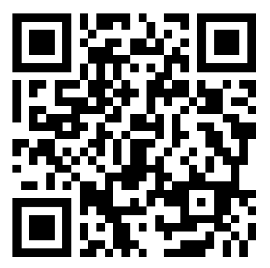
St. Michael and All Angels
Quiz Supper
A highly entertaining quiz,
a delicious supper
and a raffle in aid of the
Heritage Conservation Fund
Saturday 18 April
Doors open 6:30pm
Tickets £25 per person
Tables of eight £200
St. Michael and All Angels Parish Hall
A glass of Prosecco on arrival
7pm three-course supper
Wine available to purchase
Bookings via Ticket Source using the QR code

